Slide 1
CSE299.1 - MSRb
f
inal
presentation
presented by
Group 2
=> Tanzeem Haque, 2131122642
=> SK Asafur Rahman, 2112430642
=> Sajid Hasan, 2222684042
=> Masud Ahmed Niloy, 1912477042
=> S. K. Sajid Anam, 2211624042

Slide 2


p
roblem Statement &
Motivation
E
Customers often struggle to choose compatible PC components.
Real-time guidance is usually missing in online stores.
An integrated AI chatbot can support customers during purchase.
Simplifies the decision-making process with interactive support.

Slide 3

E
Browse and compare PC components
AI chatbot responds to product-related queries
Automatically adds products to cart upon request
K
ey Features
Simple user interface with real-time cart updates

Slide 4

AI in E-commerce
Chatbots: Offer 24/7 support, handle queries, and recommend products.
Challenges: Consumer skepticism, privacy concerns, and tech maturity limit adoption.
AI Applications
E
Automating Tasks: Personalizes recommendations, predicts behavior, and enhances search functions
Consumer Reception & Limitations
Acceptance: Shaped by convenience, efficiency, and enjoyment.
Limitations: Struggles with complex queries and ethical concerns.
L
iterature Review

Slide 5

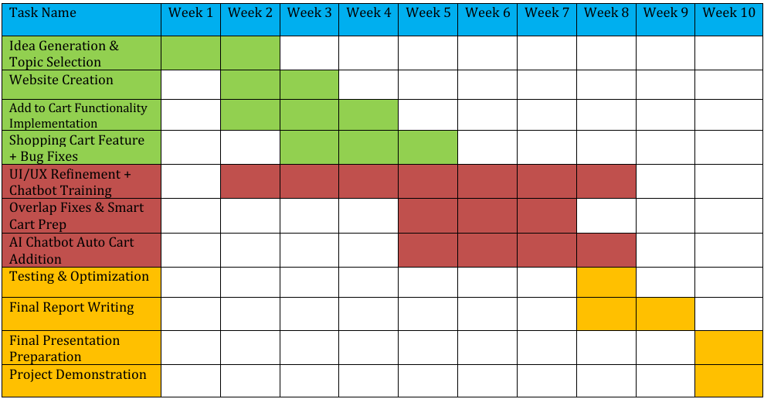
E
Project Overview & Architecture
->
Two main components:
Web store interface for browsing and purchasing
AI Chatbot for real-time customer assistance
->
Communication via Flask API between front-end and AI model
->
Chatbot powered by Ollama framework with a local model

Slide 6
Tested chatbot accuracy, context retention, cart interaction.
Challenges: Context reset, vague queries, repetition.
E
Metrics: Precision, Recall and response time.
Recommendation Accuracy: 89%, Cart Success: 91%.
Experiment & Analysis

Slide 7

I
mpact of the
Project
Societal: Improves efficiency, raises privacy concerns.
Legal: Needs clear data handling rules.
Cultural: Adoption varies globally.
Sustainability: AI can reduce waste and emissions, but consumes power.

Slide 8
e
ngineering Problems & Activities
Problems: Real-time cart + AI integration, data accuracy, UI/UX.
Activities: Used NLP + ML knowledge to build chatbot.
E
Innovation: Combined product recommendation with cart control.
Challenges were new and required creative solutions.

Slide 9

Project delivered a chatbot-enabled PC component store.
E
Real-world application of conversational AI
Limitations: Model speed, hardware, and lack of security.
C
onclusion

Slide 10
Thank You!
E

